Slide 1
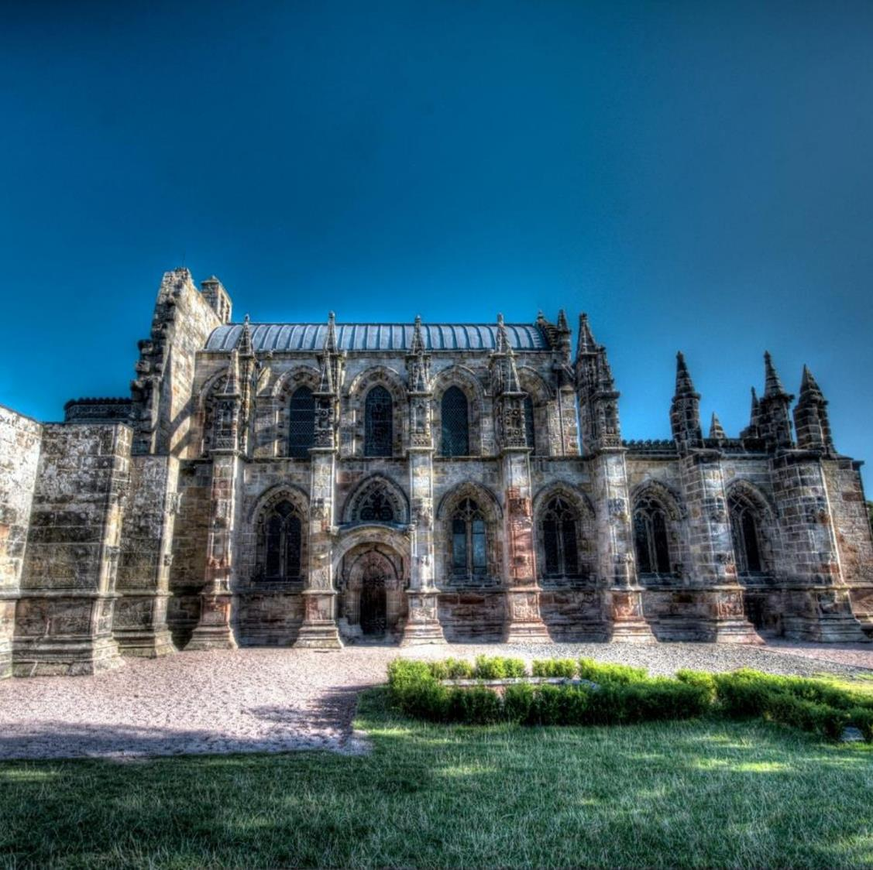
You are about to visit Rosslyn Chapel
This slideshow will give you a taster of what is to come …

Slide 2
5 Key facts about Rosslyn Chapel
Rosslyn Chapel was founded in 1446, during the Medieval period
It was built by Sir William St Clair, 11th Baron of Rosslyn and Prince of Orkney
Sir William intended it to be a great cathedral, but work stopped in 1484 when he died leaving the building as a small church
It is covered inside and outside with stone carvings
Many of the carvings are mysterious and no one knows exactly what they mean!

Slide 3
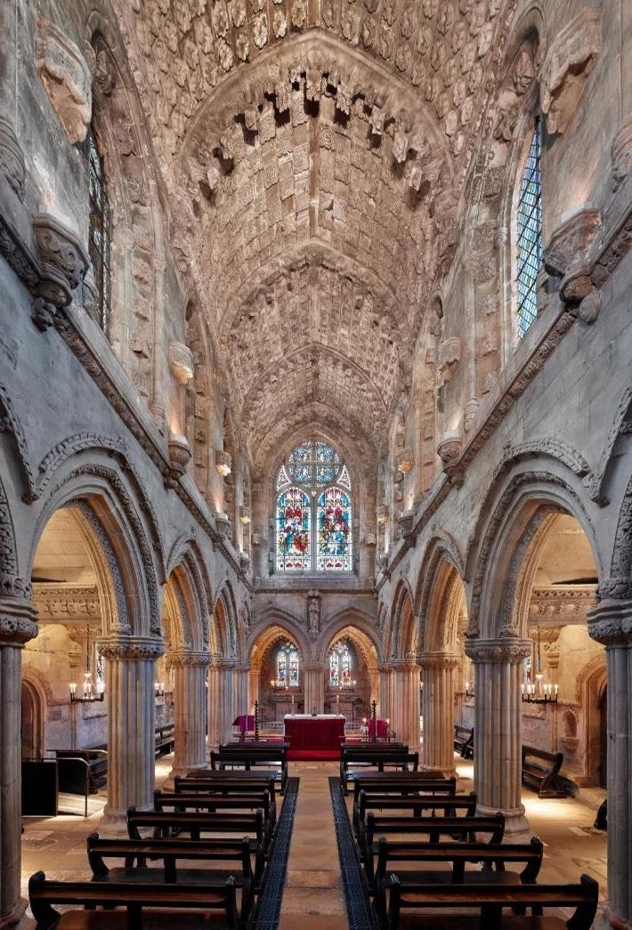
Our Top 5
The next slides show our top five things to look for when you visit the Chapel.

Slide 4
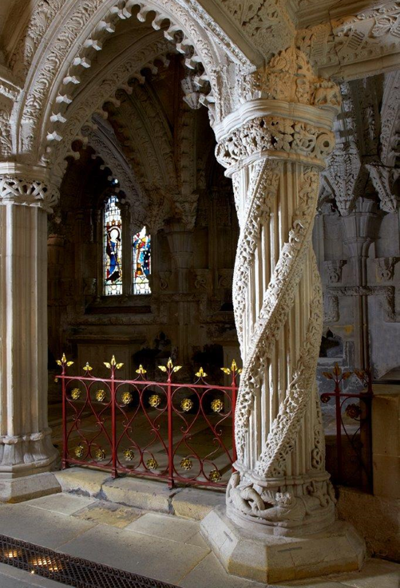
1. The Apprentice Pillar
The Apprentice Pillar is probably the most famous feature at Rosslyn Chapel.
Some people say the pillar is meant to be the Tree of Life from the Garden of Eden in the Bible. Others say it is also meant to be Yggrdasil, the tree of life from Norse Myth, which had evil dragons chewing at its roots, trying to destroy the world by bringing down the tree. The Apprentice Pillar has dragons chewing the roots of its vines, too. Can you spot them?
There is a gruesome murder story attached to this pillar – if you have time during your visit, why not ask one of the Chapel Guides to tell you the story?

Slide 5
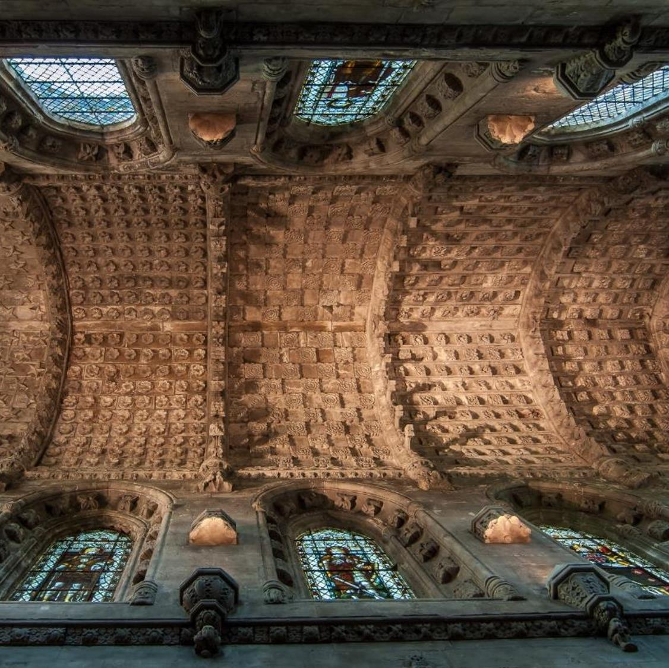
2. The Carved Ceiling
The barrel-vaulted stone ceiling is covered in flowers and stars.
In medieval times flowers held different symbolic meanings and decorating the building with them was like using a visual code to tell a message in the stone.
Almost all the carvings at Rosslyn Chapel have symbolic meaning. Today we don’t know what all the meanings are which is why the building is such a mystery and there are so many myths and legends about it.

Slide 6
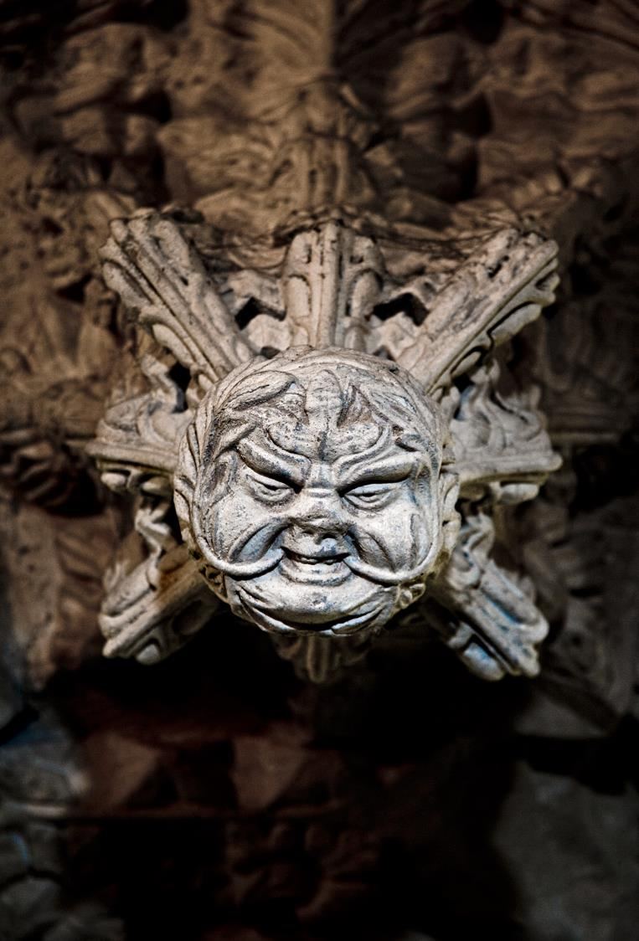
3. The “Green Men”
Green men are mysterious faces with leaves growing out of their mouths and nostrils. There are over 100 of them at Rosslyn Chapel.
They represent nature, especially the way it grows back in the Spring after dying back in the winter.
This aspect of nature was often used to express the central story in Christianity of the Resurrection of Jesus, who rose to life again after dying on the Cross. In medieval times it was common to use images of nature and Springtime when celebrating the Resurrection, for example in Easter songs. Is this what the Green Men mean here at Rosslyn Chapel?

Slide 7
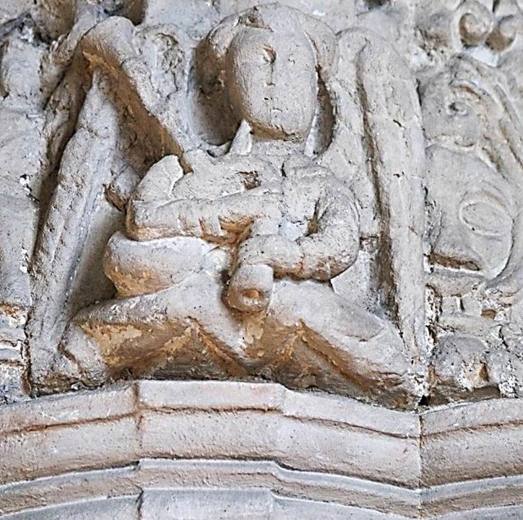
4. Angel Playing the Bagpipes
This is one of the earliest depictions of the bagpipes in Scotland!
This angel is surrounded by other angels playing a variety of medieval instruments. You will find them perched on top of the pillars in the Lady Chapel.
Near the angels is a carving of the Christmas nativity scene with Mary holding baby Jesus by the manger, the shepherds and the three wise men. The angels are meant to be a choir welcoming Jesus into the world with heavenly music.

Slide 8
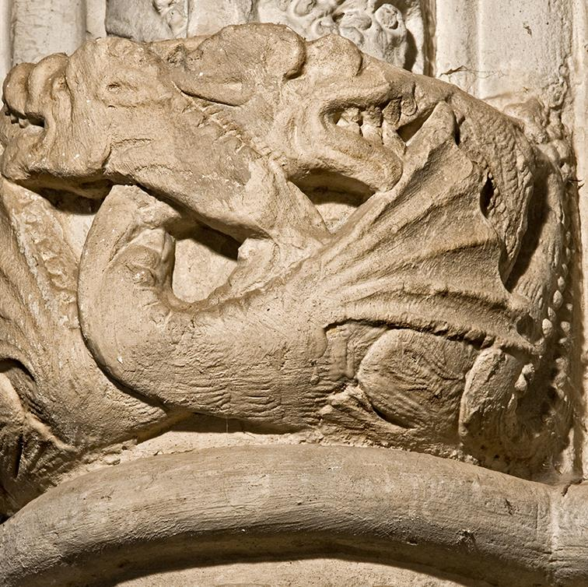
5. Two Dragons Fighting
These two dragons are from the tales of King Arthur and the magician Merlin.
One day when Merlin was a boy, he fell asleep and had a dream where he saw a red and a white dragon fighting each other. The two dragons represented the ancient Britons and the Saxons who were fighting to control Britain. Merlin’s dream was a vision showing the future.
The Arthurian legends were very popular when the Chapel was built – they were a bit like the Harry Potter stories of the Medieval World.

Slide 9
Find out more
Pre-visit
Download our “visual story” autism guide for more information about what a visit to Rosslyn Chapel is like
Pre- and post-visit
We have a range of online learning resources on all sorts of topics on the Rosslyn Chapel website
During your visit
Pick up a copy of our “Children’s Guide” leaflet. It is full of interesting information about the Chapel and interesting things to do.
Post-visit
Email learning@rosslynchapel.com with any questions you may have. We will always be happy to help.

Slide 10
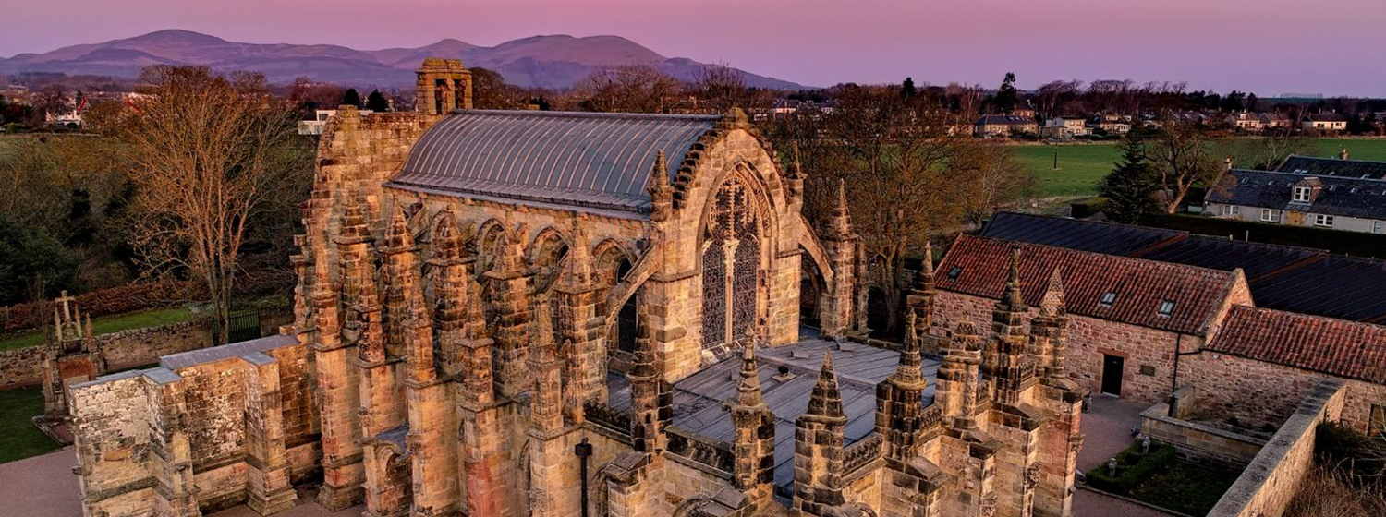
We look forward to welcoming you to Rosslyn Chapel!

